Slide 1
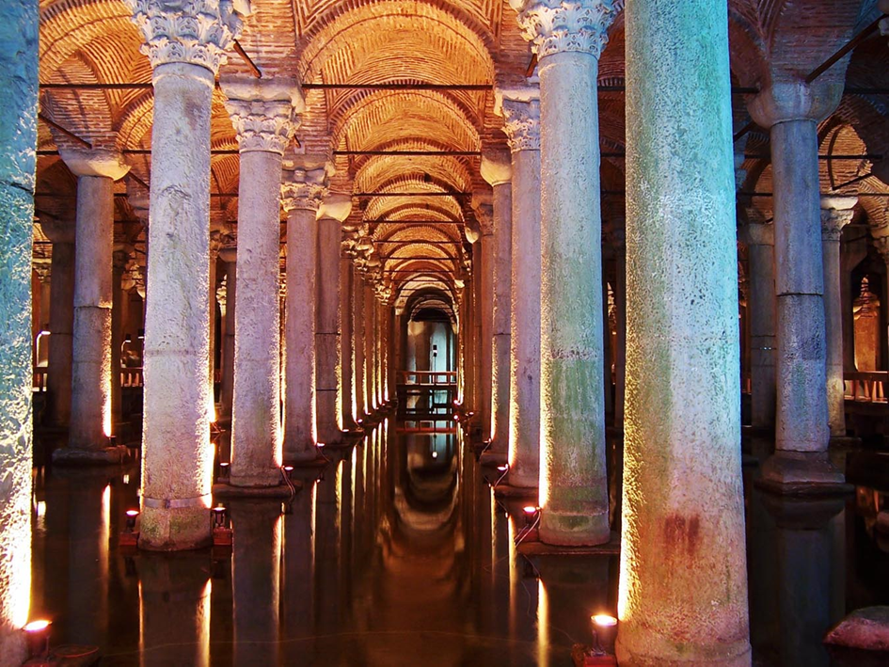
THE BASILICA SISTERN

Slide 2
The Basilica Cistern , is the largest of several hundred ancient cisterns that lay beneath the city of Istanbul. The cistern, located southwest of the Hagia Sophia on the historical peninsula of Sarayburnu, was built in the 6th century during the reign of Byzantine Emperor Justinian I.

Slide 4
The Basilica Cistern also known as the "Sunken Palace" was constructed by Justinian in 532 to supply water to the Byzantine Palace primarily. Underground waterway was used as a reservoir for water storage for the Great Palace and other buildings. It is 132 m length and 65m wide. There are 336 columns in the cistern. Most of the column capitals are either in Corinthian or Doric Style. You can find one upside down Medusa head supporting one of the columns at the back of Basilica Cistern. Why it is upside down has been a question of much discussion, but the best guess is that the people who placed the stone believed that if the head was upside down, it would ward off evil spirits.

Slide 6
Originally, there was a stone-paved circle on the cistern. It was later broken by dense housing construction beginning in the Byzantine period continuing into the Ottoman period. The citizens who settled in the vicinity were provided with their daily water requirements from the large round well-like holes opening from the ceiling structure. In 1940, several of the structures built on and around the Basilica Cistern were nationalized and a neat building was constructed at the entrance of the Cistern by the Istanbul Metropolitan Municipality. It was also exposed to a wide range of cleaning process between 1985-1988. Thus dirty water and tons of mud were removed and a promenade platform was built in the cistern. After the cleaning process was completed, the two Medusa heads, masterpieces of the First Age Art of Statuary were used as pedestals at the bottom of the two columns in the northwest corner of the cistern. It is not known exactly when or for what purpose the were antique Medusa and Gorgon heads were brought to the Basilica Cistern.

Slide 7
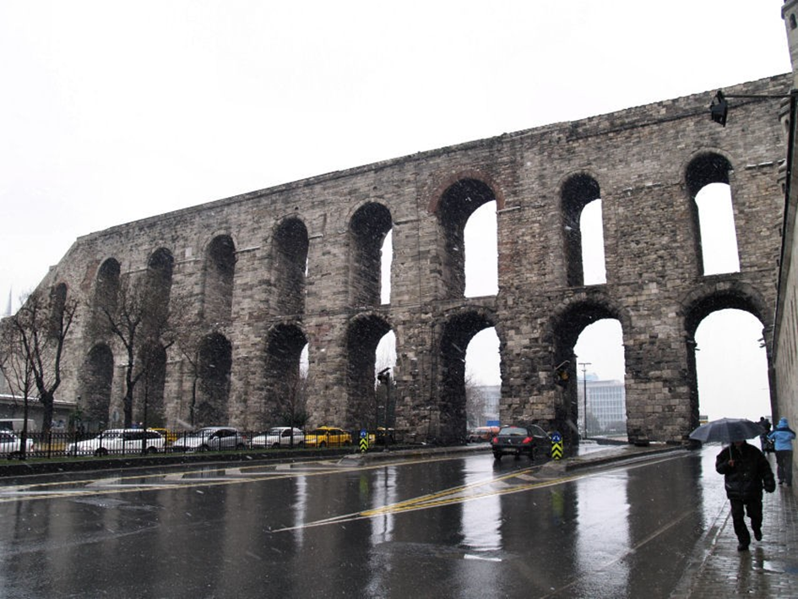
Valens Aqueduct :
The cistern could hold 80.000 cubic meters of water, coming from the Eğrikapı Water Distribution Centre in the Belgrade Forest, 19 kilometers from the city. The water was transported to the city center via the 971-meter-long Valens Aqueduct (Bozdoğan Sukemeri) and the 11.545-meter-long Mağlova Aqueduct (Mağlova Sukemeri), which was built by Emperor Justinian I.

Slide 8
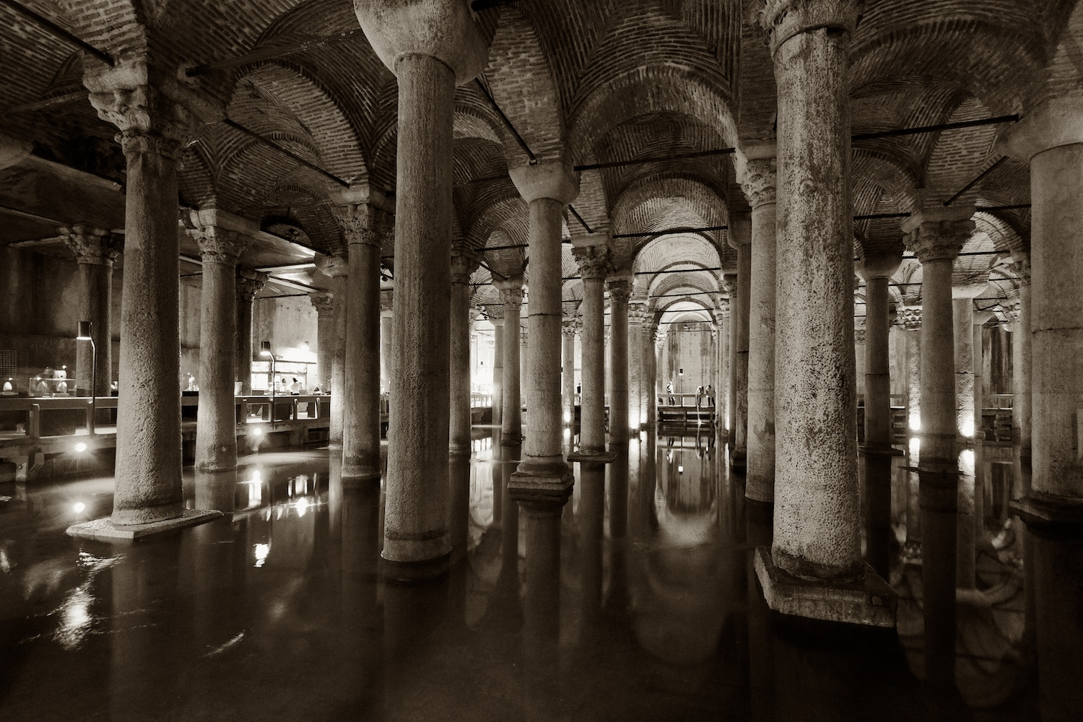
The cistern was forgotten for centuries and only accidently rediscovered by the Frenchman Peter Gyllius in 1545. While researching Byzantine antiquities in the city, he noticed that people in the neighborhood not only got a hold of water by simply lowering buckets through holes in their basements, they miraculously sometimes even caught fish this way.

Slide 9
MEDUSA COLUMN BASES

Slide 10
Located in the northwest corner of the cistern, the bases of two columns reuse blocks carved with the visage of Medusa. The origin of the two heads is unknown, though it is thought that the heads were brought to the cistern after being removed from a building of the late Roman period. There is no written evidence that suggests they were used as column pedestals previously. Tradition has it that the blocks are oriented sideways and inverted in order to negate the power of the Gorgons' gaze however it is widely thought that one was placed sideways only to be the proper size to support the column. The upside down Medusa was placed that way specifically because she would be the same height right side up.

