Slide 1
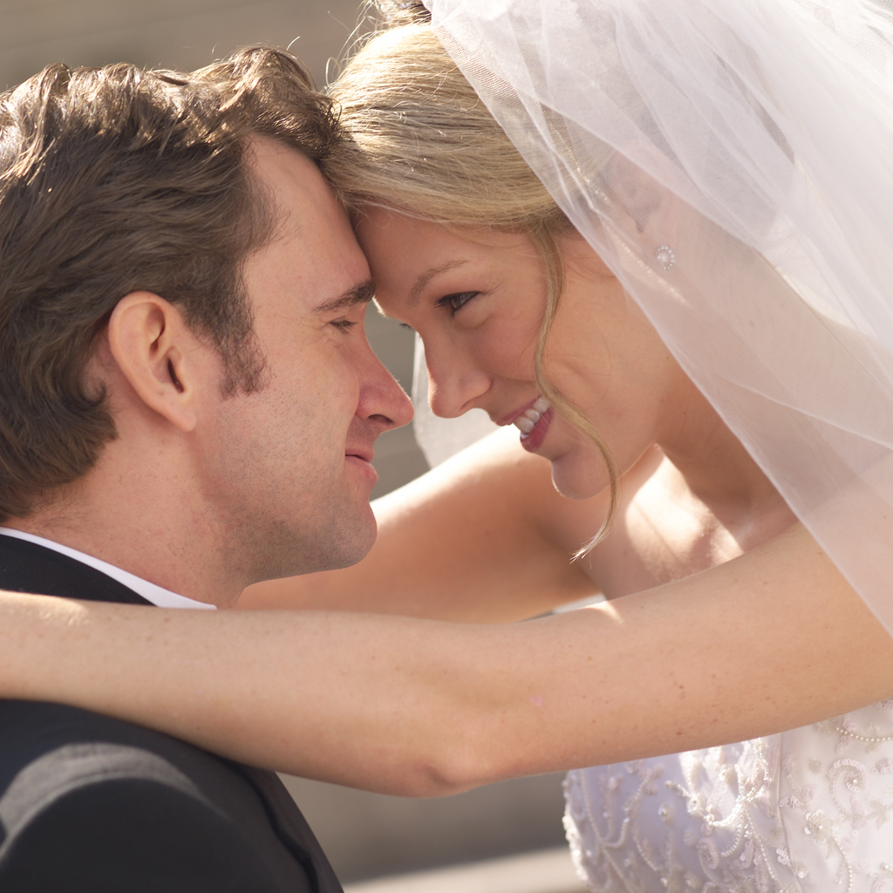
Turkish Wedding Ceremonies

Slide 2
Turkish Wedding Ceremonies
Preparing for the Wedding
Turkey is a 99% Muslim country, but it's also a secular one. Islam, therefore, rules many wedding tradtions, but there are also traditions for the civil part of a wedding. Weddings in Turkey are a lavish affair with celebrations that may last for several days before and after the actual marriage ceremony. The traditional gifts for the bride and groom are money and gold. There are no European or American style wedding lists. Prior to the wedding, the respective families buy furniture and household goods for the young couple. Guests do not give the newlyweds towels, toasters or pots. Instead, they shower the bride, literally, with banknotes and coins.
Every jeweler in Turkey sells coins for the occasion. Red is the color of good luck and fortune; therefore, the gold coins, which serve as wedding gifts, come with a tiny red silk bow and a pin attached. On the evening of the marriage ceremony, bride and groom make their formal entrance. When possible, depending on the social and financial standing of the families, the ceremony is held in a ballroom. Bride and groom sit down at a lavishly decorated table with the witnesses by their side. A government official presides over the civil part of the ceremony, which is the signing of the relevant documents.

Slide 3
Turkish Wedding Ceremonies
Act of go-between (Görücülük), To Ask a Girl’s Hand in Marriage:
In the traditional setting, the courtship process leading up to a marriage begins with seeing and looking for a girl. Families who want to marry their sons begin looking out for girls, starting with their relatives, neighbours and close friends. They get willing assistance in this “search” from their relatives, neighbours and friends.
In larger cities of Turkey, where cultural changes have been more rapid, it is now most common that people meet up personally and develop a relationship directly. However, “Görücülük” has been still the main type of interaction enabling marriages is more traditional communities and rural areas. “Görücülük” is the act of go-between of several women of a family or friends of a man who wants to get married, who pay special visit to the home of the girl who they see as a potential fit to the man, to examine the girl closely and reveal their intentions. This procedure is called “seeing a girl, to send women to see a girl, woman sent out to inquire about a prospective bride” (“kız bakma”, “görücü çıkma”, “dünür gezme” in Turkish).

Slide 4
Turkish Wedding Ceremonies

Slide 5
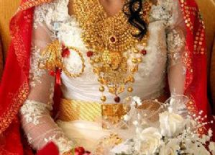
Turkish Wedding Ceremonies
This is an necklace that we buy for the bride and juwelrys

Slide 6
Turkish Wedding Ceremonies
The Wedding Dress
For most of the brides, their wedding dress is their first fashionable dress because in the Ottoman culture, young girls are forbidden to wear fashionable clothes. Their wedding dress becomes their first ornamented dress of life. The bride wears a bright wedding dress and veil, adorned with a red sash around her waist and red bows on her dress or in her hair. The bridal veil is also important, but nowadays, traditions are changing and even the traditional marriages have brides wearing dresses without bridal veils. Bright colors are worn because they reflect joy and happiness. The groom is dressed in a tuxedo or dark suit.

Slide 7
Turkish Wedding Ceremonies

Slide 8
Turkish Wedding Ceremonies
Once the documents have been signed, the newly married couple opens the first dance. The bride, accompanied by her female relatives, then makes the rounds of her guests, carrying a basket lined in red. Guests kiss the bride, can pin a gold coin on her sash, may also slip a gold bracelet on her wrist, and deposit money in the basket. Afterward, the bride often changes from her white dress into a red or purple traditional gown, which is richly embroidered in gold. She wears a red veil over her head. Female guests and relatives are invited to form a circle around her, and then her hands and the palms of her guests are painted with henna for good luck.
The wedding dinner, which consists of many courses, follows. During the meal, traditional music is played, and often, professional dancers perform. An important part of the celebration is the 'Dance of the Fathers', where the fathers of the bride and groom dance around each other and are equally showered with banknotes and gold coins.
Finally, the bride and groom cut the wedding cake. Each guest is given a piece to be consumed after dinner. The rest is packed in small parcels to be taken home. The bride and groom stay with their guests until the end of the celebration. They do not sneak out to start their honeymoon early, but traditionally spend their first night in the hotel where the wedding reception takes place.

