Slide 1
dsfadfasdfasdf
SILK ROAD

Slide 2
The Silk Road or Silk Route is a historical network of interlinking trade routes across the Afro-Eurasian landmass that connected East, South, and Western Asia with the Mediterranean and European world, as well as parts of North and East Africa. The Silk Road includes routes through Syria, Turkey, Iran, Turkmenistan, Uzbekistan, Kyrgyzstan, Pakistan and China..

Slide 3
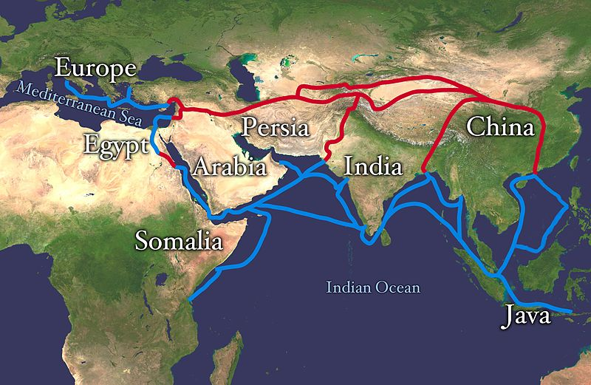
Silk Road extending from Europe through Egypt, Somalia, the Arabian Peninsula, Iran, Afghanistan, Central Asia,Sri Lanka, Pakistan, India, Bangladesh, Burma, Java-Indonesia, and Vietnam until it reaches China. The land routes are red, and the water routes are blue.

Slide 4
Extending 4,000 miles (6,437 kilometres), the Silk Road gets its name from the lucrative Chinese silk trade which was carried out along its length, and began during the Han Dynasty (206 BC – 220 AD). The central Asian sections of the trade routes were expanded around 114 BC by the Han dynasty, largely through the missions and explorations of Zhang Qian, but earlier trade routes across the continents already existed.

Slide 5
Opening of the Silk Road
The "Silk Road" originated during the 1st century BC, following efforts by the Yuezhi and Xiongnu in the Tarim Basin to consolidate a road to the Western world and India, both through direct settlements in the area of the Tarim Basin and diplomatic relations with the countries of the Dayuan, Parthians and Bactrians further west. The Silk Roads were a "complex network of trade routes" that gave people the chance to exchange goods and culture.

Slide 6
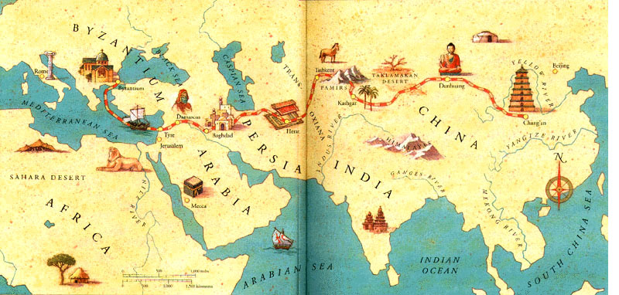

Slide 7
Trade on the Silk Road was a significant factor in the development of the civilizations of China, the Indian subcontinent, Persia, Europe and Arabia. Though silk was certainly the major trade item from China, many other goods were traded, and various technologies, religions and philosophies, as well as the bubonic plague (the "Black Death"), also traveled along the Silk Routes.
The main traders during Antiquity were the Indian and Bactrian traders, then from the 5th to the 8th century the Sogdian traders, then afterward the Arab and Persian traders.

Slide 8
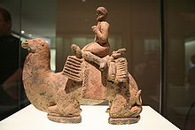
HISTORICAL GOODS

Slide 9
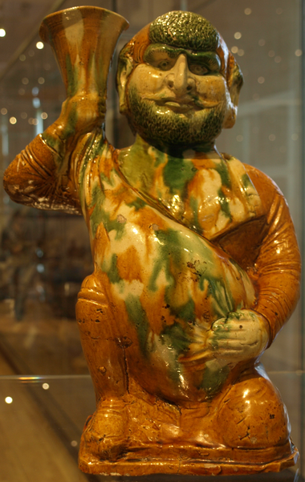
A Chinese Western Han Dynasty
bronze rhinoceros with gold and silver inlay.

Slide 10
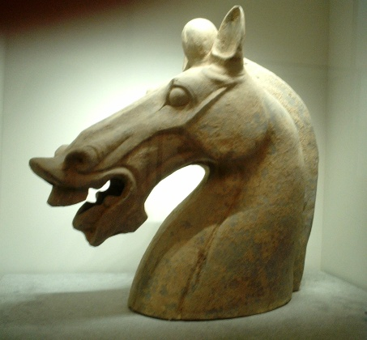
A pottery horse head and neck (broken from the body) of the Late Han Dynasty

Slide 11
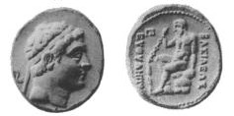
Coin depicting the Greco-Bactrian king Euthydemus

