Slide 1
1950s & 1960s TURKISH IMMIGRATION TO GERMANY

Slide 2
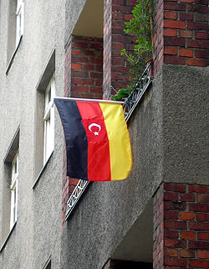
Turks in Germany, moved to Germany from Turkey and the Turks settled. Turks born in Germany and covers the broad definition. Initially described as Almancılar group, winning the title of today does not adopt a negative connotation. Permanent location of the previous definition of expatriates living in the country, who perform various professions and some of them, especially the next generation of the citizenship of their country does not fully express the Turks. In the past 40 years, around three million people emigrated from Turkey to Germany.

Slide 3
HISTORY Sent to the Ottoman Empire and the German industry firsts studying for vocational education, and especially the Turks who worked in the defense industry. Need of the labor force in the 1960s in Germany, before Italy, Spain, Portugal and Greece, and finally opened its doors to countries such as Turkey, people recognized the possibility of migration. Turkey's, mainly by the financial situation of these immigrants in Germany a better position. Objectives work, collecting money in a short time to go back to Turkey, which is a very small part of this group returned to Turkey. Brought from Turkey, a majority of families continued to live in Germany. However, Germany in 1973, closed its doors to immigrants. Despite this, the Turks, or to enter the country illegally continued to seek refuge.

Slide 4
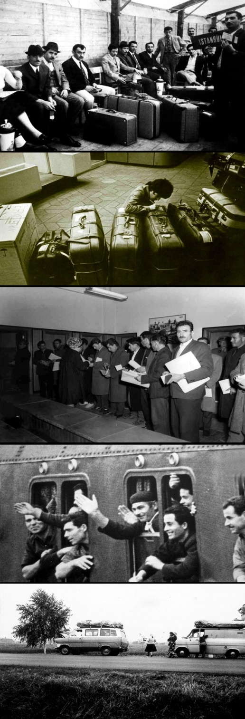
Immigrants who immigrated from Turkey in Germany showed themselves in many areas, particularly in the fields of culture and the economy have been effective. Their annual holidays, Turkey severed its ties with the homeland. Watching television and newspapers as well as to the Turkish press, many of the Christian way of life is dominated by Germany, continue to live according to Islamic values. Turks in Germany in 1960 and then went to find a job, and now lived in Germany until today, the number of 3rd generation reached exponentially

Slide 5
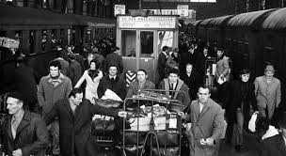
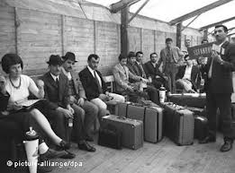
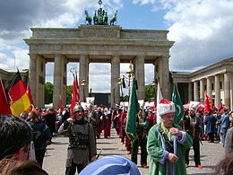
PICTURES

Slide 6
