Slide 1
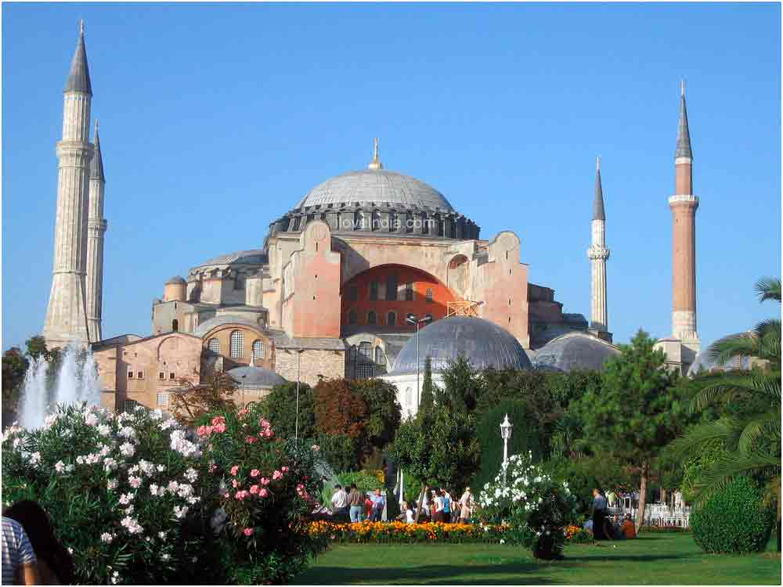
HAGIA SOPHIA

Slide 2
Hagia Sophia is a former Orthodox patriarchal church later a mosque, and now a museum in Istanbul, Turkey. From the date of its construction in 537 until 1453, it served as an Eastern Orthodox cathedral and seat of the Patriarchate of Constantinople except between 1204 and 1261, when it was converted to a Roman Catholic cathedral under the Latin Empire. The building was a mosque from 29 May 1453 until 1931. It was then secularized and opened as a museum on 1 February 1935.

Slide 3
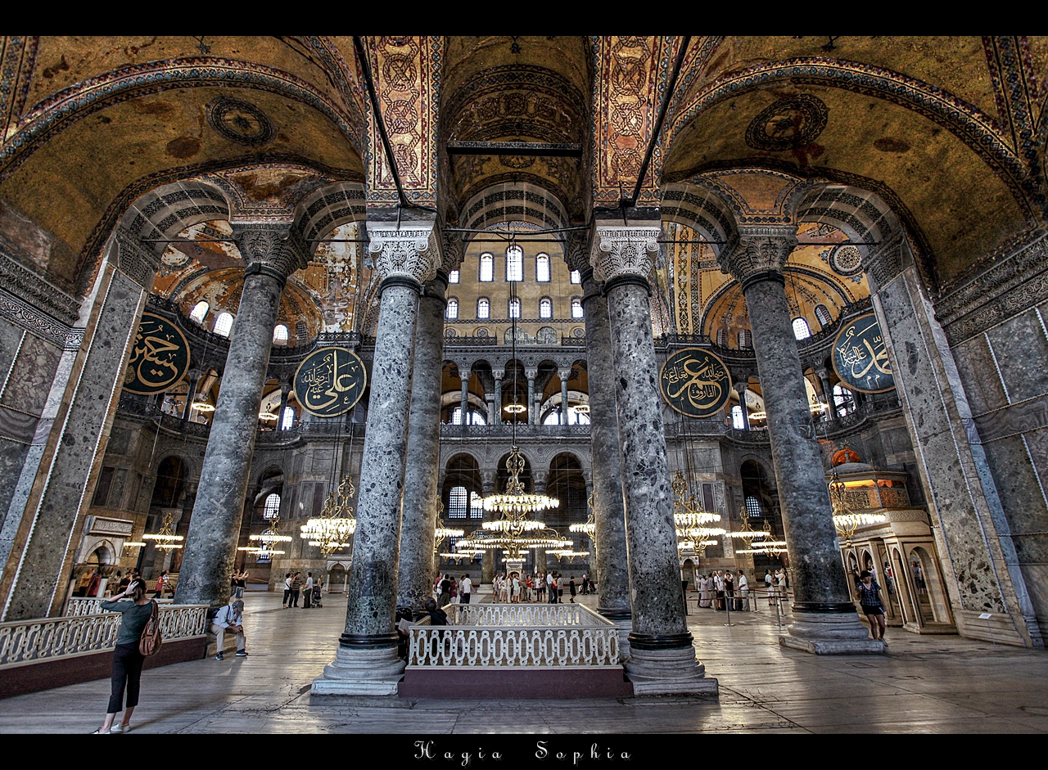
HISTORY

Slide 4
FIRST CHURCH
Inaugurated on 15 February 360 (during the reign of Constantius II) by the Arian bishop Eudoxius of Antioch it was built next to the area where the imperial palace was being developed. The nearby Hagia Eirene ("Holy Peace") church was completed earlier and served as cathedral until the Hagia Sophia was completed. Both churches acted together as the principal churches of the Byzantine Empire.
Writing in 440, Socrates of Constantinople claimed that the church was built by Constantius II, who was working on it in 346.A tradition which is not older than the 7th – 8th century, reports that the edifice was built by Constantine the Great.Zonaras reconciles the two opinions, writing that Constantius had repaired the edifice consecrated by Eusebius of Nicomedia, after it had collapsed.Since Eusebius was bishop of Constantinople from 339 to 341, and Constantine died in 337, it seems possible that the first church was erected by the latter.The edifice was built as a traditional Latin colonnaded basilica with galleries and a wooden roof. It was preceded by an atrium. It was claimed to be one of the world's most outstanding monuments at the time.

Slide 5
SECOND CHURCH
A second church was ordered by Theodosius II, who inaugurated it on 10 October 415. The basilica with a wooden roof was built by architect Rufinus. A fire started during the tumult of the Nika Revolt and burned the second Hagia Sophia to the ground on 13–14 January 532.
Several marble blocks from the second church survive to the present; among them are reliefs depicting 12 lambs representing the 12 apostles. Originally part of a monumental front entrance, they now reside in an excavation pit adjacent to the museum's entrance after they were discovered in 1935 beneath the western courtyard by A. M. Schneider. Further digging was forsaken for fear of impinging on the integrity of the building.

Slide 6
THIRD CHURCH
On 23 February 532, only a few weeks after the destruction of the second basilica, Emperor Justinian I elected to build a third and entirely different basilica, larger and more majestic than its predecessors. Justinian chose physicist Isidore of Miletus and mathematician Anthemius of Tralles as architects; Anthemius, however, died within the first year of the endeavor. The construction is described in the Byzantine historian Procopius' On Buildings.
The construction is described in the Byzantine historian Procopius' On Buildings The emperor had material brought from all over the empire – such as Hellenistic columns from the Temple of Artemis at Ephesus, large stones from quarries in porphyry from Egypt, green marble from Thessaly, black stone from the Bosporus region, and yellow stone from Syria. More than ten thousand people were employed. This new church was contemporaneously recognized as a major work of architecture. The theories of Heron of Alexandria may have been utilized to address the challenges presented by building such an expansive dome over so large a space.[citation needed] The emperor, together with the Patriarch Menas, inaugurated the new basilica on 27 December 537 with much pomp. The mosaics inside the church were, however, only completed under the reign of Emperor Justin II (565–578).

Slide 7
ARCHITECTURE
Hagia Sophia is one of the greatest surviving examples of Byzantine architecture.Its interior is decorated with mosaics and marble pillars and coverings of great artistic value. The temple itself was so richly and artistically decorated that Justinian proclaimed, "Solomon, I have outdone thee. Justinian himself had overseen the completion of the greatest cathedral ever built up to that time, and it was to remain the largest cathedral for 1,000 years up until the completion of the cathedral in Seville in Spain

Slide 8
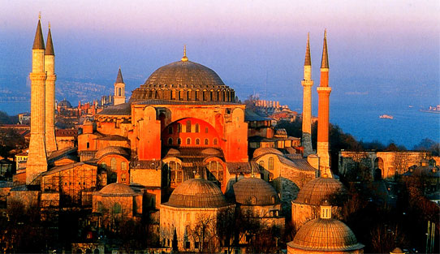

Slide 9
DOME
The dome of Hagia Sophia has spurred particular interest for many art historians, architects and engineers because of the innovative way the original architects envisioned it. The cupola is carried on four spherical triangular pendentives, an element which was first fully realized in this building. The pendentives implement the transition from the circular base of the dome to the rectangular base below, restraining the lateral forces of the dome and allow its weight to flow downwards. They were reinforced with buttresses during Byzantine and later during Ottoman times, under the guidance of the architect Sinan. The weight of the dome remained a problem for most of the building's existence. The original cupola collapsed entirely after the quake of 558; in 563 a new dome was built by Isidore the younger, a nephew of Isidore of Miletus. Unlike the original, this included 40 ribs and was slightly taller, in order to lower the lateral forces on the church walls. Larger section of the second dome collapsed as well, in two episodes, so that today only two sections of the present dome, in the north and south side, still date from the 562 reconstruction. Of the whole dome's 40 ribs, the surviving north section contains 8 ribs, while the south section includes 6 ribs.

Slide 10
MINARETS
One of the minarets (at southwest) was built from red brick while the other three were built from white limestone and sand stone; of which the slender one at northeast was erected by Sultan Bayezid II while the two larger minarets at west were erected by Sultan Selim II and designed by the famous Ottoman architect Mimar Sinan.

Slide 11
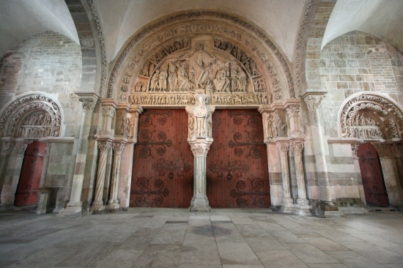

Slide 12
NARTHEX AND PORTALS
The Imperial Gate was the main entrance between the exo- and esonarthex. It was reserved only for the emperor. The Byzantine mosaic above the portal depicts Christ and an unnamed Emperor.
A long ramp from the northern part of the outer narthex leads up to the upper gallery.

Slide 13
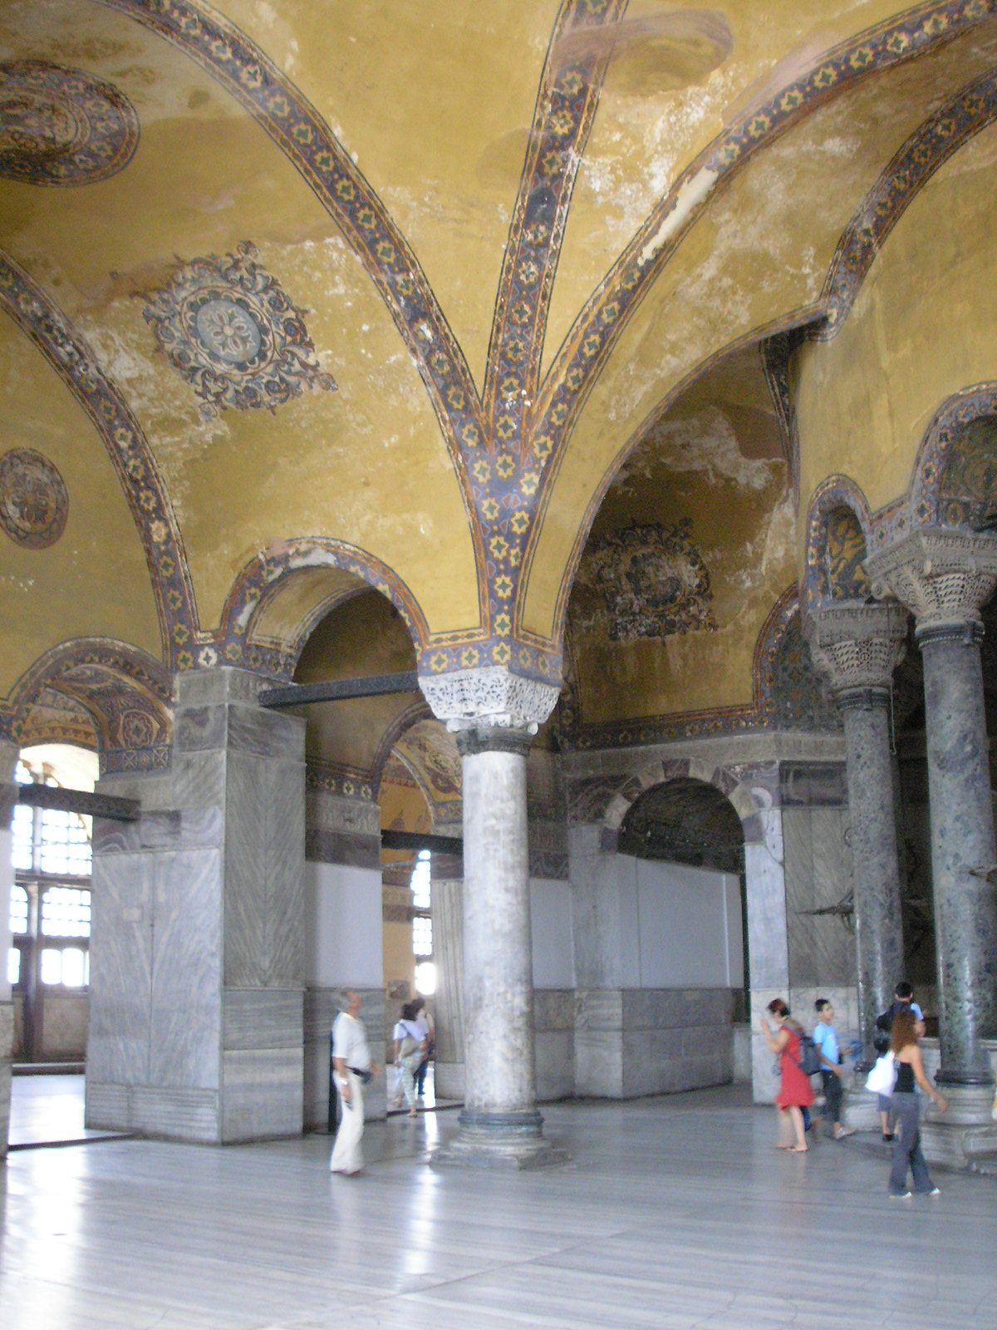

Slide 14
UPPER GALLERY
The upper gallery is laid out in a horseshoe shape that encloses the nave until the apse. Several mosaics are preserved in the upper gallery, an area traditionally reserved for the empress and her court. The best-preserved mosaics are located in the southern part of the gallery.
The upper gallery contains runic graffiti presumed to be from the Varangian Guard.

Slide 15
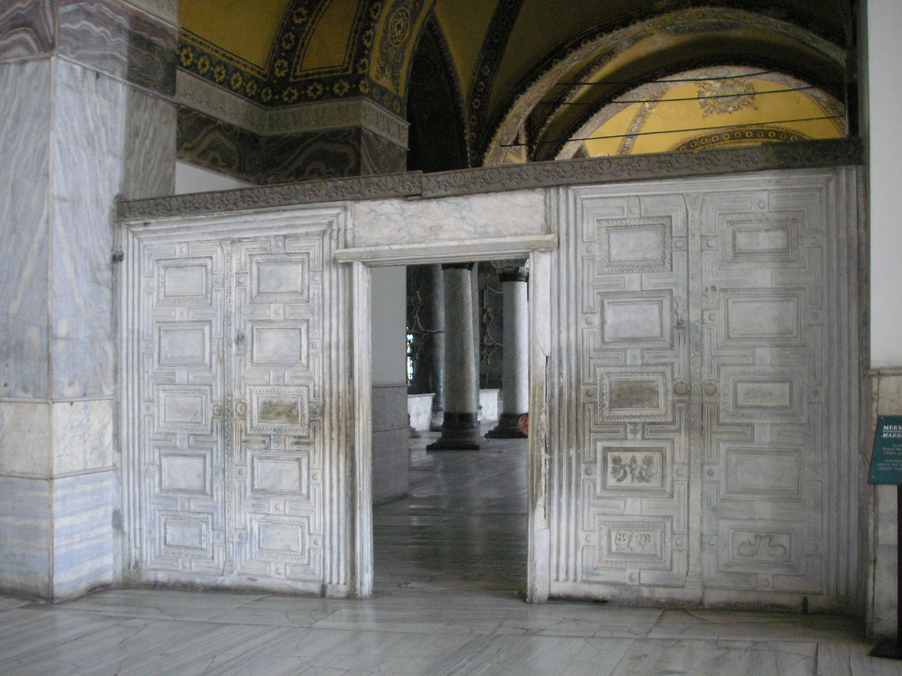

Slide 16
MARBLE DOOR
The Marble Door inside the Hagia Sophia is located in the southern upper enclosure, or gallery. It was used by the participants in synods, they entered and left the meeting chamber through this door.

Slide 17
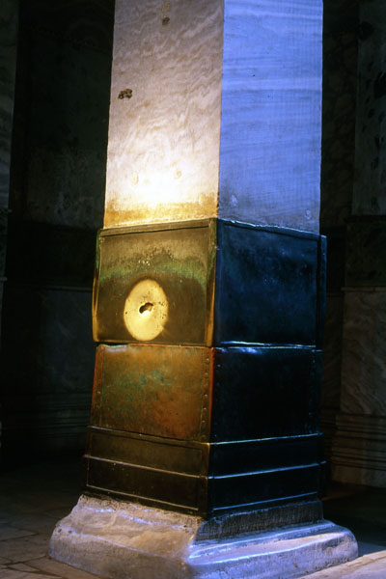

Slide 18
WISHING COLUMN
At the northwest of the building there is a column with a hole in the middle covered by bronze plates. This column goes by different names; the perspiring column, the wishing column, the sweating column or the crying column. The column is said to be damp when touched and have supernatural powers.

