Slide 1
NATIONAL SOVEREIGNTY AND CHILDREN’S DAY

Slide 2
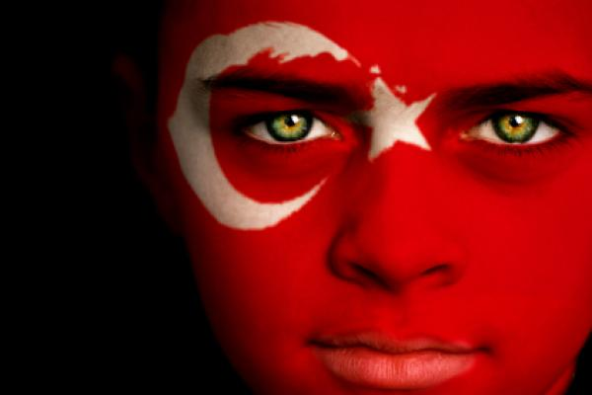
Solemn ceremonies and childrens festivals take place throughout Turkey on National Sovereignty and Children’s Day. Children take seats in the Turkish Parliment and symbolically govern the country for one day.

Slide 3
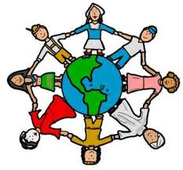
Atatürk says that children are the future of a country and then he gave this to all children of the world as a present. The biggest ceremony takes place at the Atatürk Mausoleum in Ankara because Atatürk dedicated this event to children. TRT brings children aged 8 to 14 from different countries around the world to Turkey. These children stay with Turkish families for a week and participate in childrens festival. The most common symbols of this event are; a globe or a circle symbolizing the world. A group of children holding hands symbolizin unity.

Slide 4
COMMEMORATION OF ATATURK YOUTH AND SPORTS DAY

Slide 5
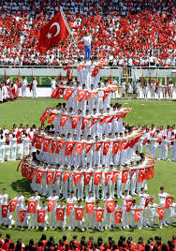
In Turkey we celebrate state ceremonies and sports events throughout the country. Young boys and girls arrange celebrations at this day.

Slide 6
WHAT DO WE DO ?
Young Turkish athletes carries our national flag from Samsun to Ankara. The marathon usually takes 10 days. Our president accepts the flag at a ceremony on may 19. Various sports events takes place on may 19. We celebrate this day by watching athletes performances at our stadiums. We lay wreaths to Atatürk’s monuments and hang flags outside our windows.

Slide 7
30TH AUGUST VICTORY DAY

Slide 8
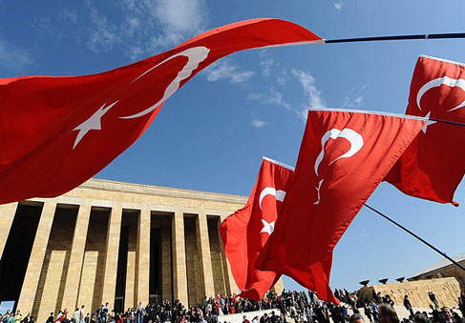
We arrange military parades and ceremonies for Mustafa Kemal Atatürk, who founded the Turkish Republic. These are some common ways to celebrate Victory Day in Turkey. Turkish flags adorns shops, public offices and people houses on this day. Victory Day is a national holiday in Turkey.

Slide 9
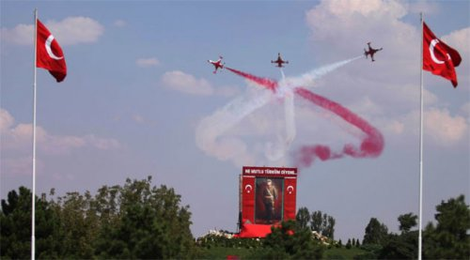
WHAT DO WE DO ?
In Turkey we celebrate Victory Day by attending military parades which take place in many big cities throughout the country. Air forces celebrate the day with demonstrations. Jets involved in such flights usually they leave red and white trails to symbolize the turkish flag.

Slide 10
29th OCTOBER REPUBLIC DAY

Slide 11
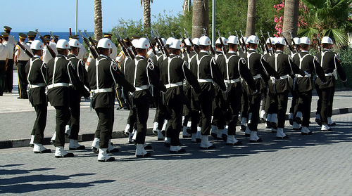
In Turkey we celebrate our freedom at Republic Day by attending military parades and participating in traditional processions with flags and musical bands.

Slide 12
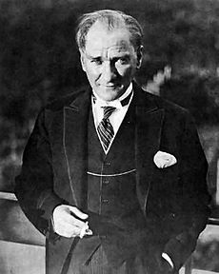
WHAT DO WE DO?
We go to stadiums on Octpber 29 to watch performances dedicated to Republic Day. Such performances usually consist of theater sketches, poetry readings, and traditional Turkish dances. Many school children participate in school performances for their parents to watch. Politicians may give public speeches. We also lay wreaths to Atatürk’s monuments or we visit Atatürk’s mausoleum in our capital, Ankara. We go there because Atatürk built our republic inspite of difficulties. He built our republic on 29th october 1923 then we start to celebrate it every year. Republic Day is national holiday in Turkey.

Slide 13
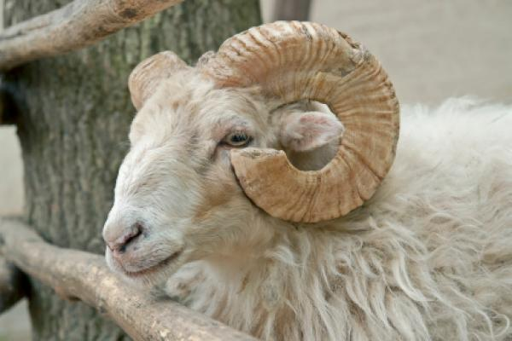
FESTIVAL OF SACRIFICES

Slide 14
In Turkey its a four-day religious festival. Our traditions in Turkey includes sacrificing an animal in a special ritual, visiting relatives and helping the poor.
WHAT DO WE DO?
Its one of the oldest Islamic holiday in Turkey. It comes about 70 days after the Ramadan feast. According to old belief its unlucky to get married or start a new business in the period between these two holidays. Maybe its a superstation. In Turkey traditionally, on the first day of this, men of each family go to a mosque for praying. In some regions people paint the sacrifice animal with henna and adorn it with ribbons. In recent years, we started making donations to charities. We give special care to help the poor during the festival of sacrifices. We cut calfs, sheeps, goats etc. at this event and we make braised meats w/ them. This is a tradition for us.

Slide 15
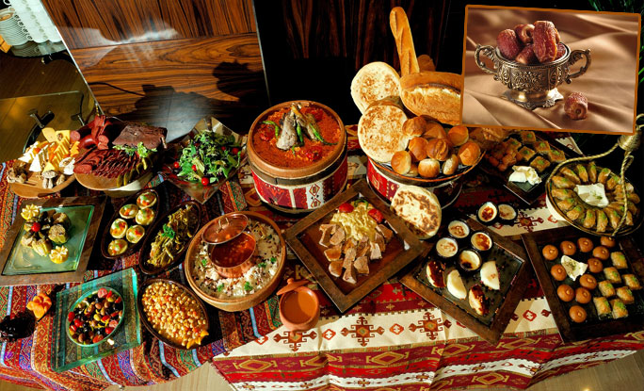
RAMADAN FEAST (EID AL-FITR)

Slide 16
In Turkey we visit our relatives, we kiss our grands hands and they give money to us. We give away sweets and deserts during the festival. Ramadan feast is a time for families to get together and join the activities such as sharing special meals.
WHAT DO WE DO?
We wake up early on the first day of this event. We wear our best clothes and we call it ‘bayramlık’. We have an alternative name for Ramadan its ‘ Sugar Feast’ turkish shadow plays such as karagöz and hacivat are popular during the Ramadan feast.

