Slide 1
Turkish Traditions
1- Turkish Foods
2-Turkish Folk Dances

Slide 2
Turkish Foods
Breakfast
Van breakfast
Yumurtalı ekmek (French toast, Turkish style)
Turks usually prefer a simple breakfast. A typical Turkish breakfast consists of cheese (beyaz peynir, kaşar), butter, olives, eggs, tomatoes, cucumbers, jam, honey, and kaymak. Sucuk (spicy Turkish sausage, can be eaten with eggs), pastırma, börek, simit, poğaça and soups are eaten as a morning meal in Turkey. A common Turkish speciality for breakfast is called menemen, which is prepared with tomatoes, green peppers, onion, olive oil and eggs. Invariably, Turkish tea is served at breakfast. The Turkish word for breakfast, kahvaltı, means "before coffee" (kahve, 'coffee'; altı, 'under').

Slide 3
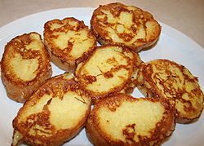

Slide 4
Turkish Foods
Homemade food
Homemade food is still preferred by Turkish people. Although the newly introduced way of life pushes the new generation to eat out, Turkish people generally prefer to eat at home. A typical meal starts with soup (in the winter), followed by a dish made with vegetables or legumes boiled in a pot (typically with meat or minced meat), then rice or bulgur pilaf in addition of a salad or cacık (made from diluted yogurt and minced cucumbers). Another typical meal is dried beans cooked with meat or pastırma mixed or eaten with rice pilaf and cacık

Slide 5
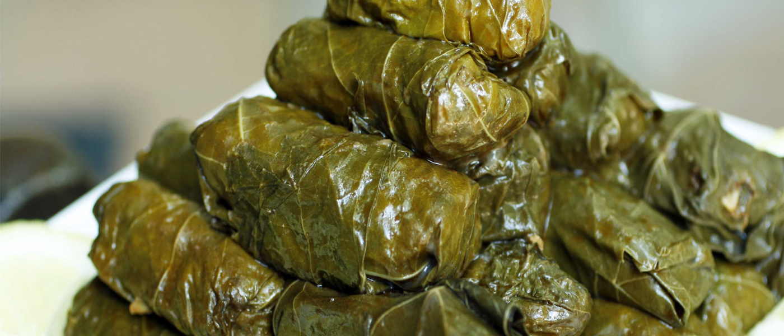

Slide 6
Turkish Foods
Restaurants
Although fast food is gaining popularity and many major foreign fast food chains have opened all over Turkey, Turkish people still rely primarily on the rich and extensive dishes of Turkish cuisine. In addition, some traditional Turkish foods, especially köfte, döner, kokoreç, börek and gözleme, are often served as fast food in Turkey. Eating out has always been common in large commercial cities. Esnaf lokantası (meaning restaurants for shopkeepers and tradesmen) are widespread, serving traditional Turkish home cooking at affordable prices.

Slide 7
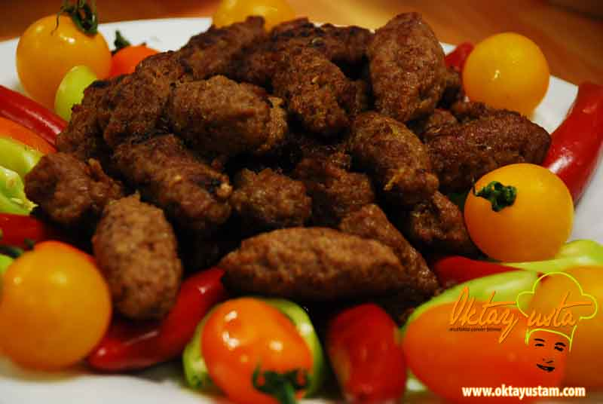
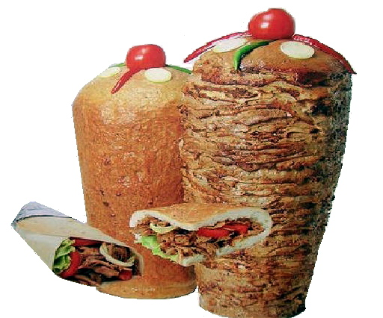
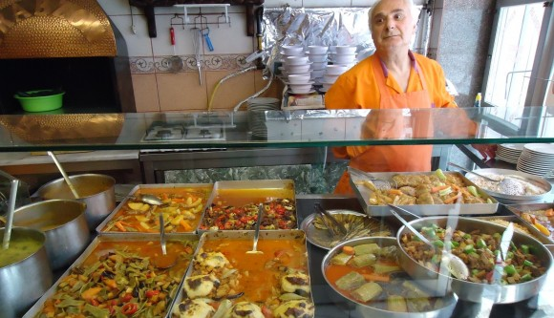

Slide 8
Turkish Foods
Fruits
The rich and diverse flora of Turkey means that fruits are varied, abundant and cheap. In Ottoman cuisine, fruit frequently accompanied meat as a side dish. Plums, apricots, pomegranates, pears, apples, grapes, and figs, along with many kinds of citrus are the most frequently used fruits, either fresh or dried, in Turkish cuisine., komposto (compote) or hoşaf (from Persian khosh âb, literally meaning "nice water") are among the main side dishes to meat or pilav. Dolma and pilaf usually contain currants or raisins. Etli yaprak sarma (vine leaves stuffed with meat and rice) used to be cooked with sour plums in Ottoman cuisine. Turkish desserts do not normally contain fresh fruit, but may contain dried varieties.

Slide 9
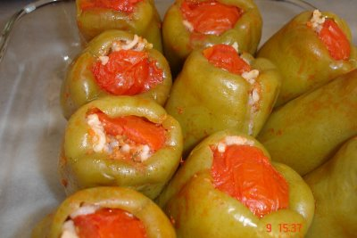

Slide 10
Turkish Foods
Meat
In some regions, meat, which was mostly eaten only at wedding ceremonies or during the Kurban Bayramı (Eid ul-Adha) as etli pilav (pilaf with meat), has become part of the daily diet since the introduction of industrial production. Veal, formerly shunned, is now widely consumed. The main use of meat in cooking remains the combination of ground meat and vegetable, with names such as kıymalı fasulye (beans with ground meat) or kıymalı ıspanak (spinach with ground meat, which is almost always served with yogurt). Alternatively, in coastal towns cheap fish such as sardines (sardalya) or hamsi (anchovies) are widely available, as well as many others with seasonal availability. Poultry consumption, almost exclusively of chicken and eggs, is common. Milk-fed lambs, once the most popular source of meat in Turkey, comprise a small part of contemporary consumption. Kuzu çevirme, cooking milk-fed lamb on a spit, once an important ceremony, is rarely seen. Because it is a predominantly Islamic country, pork plays no role in Turkish cuisine.

Slide 11
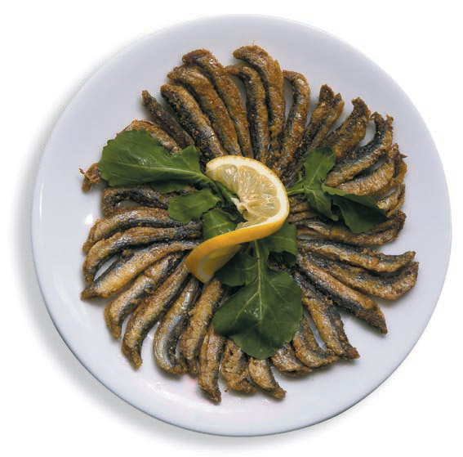
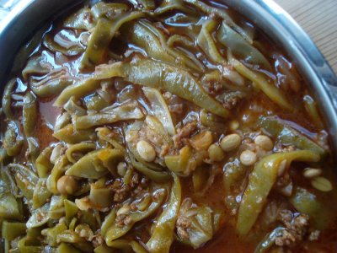
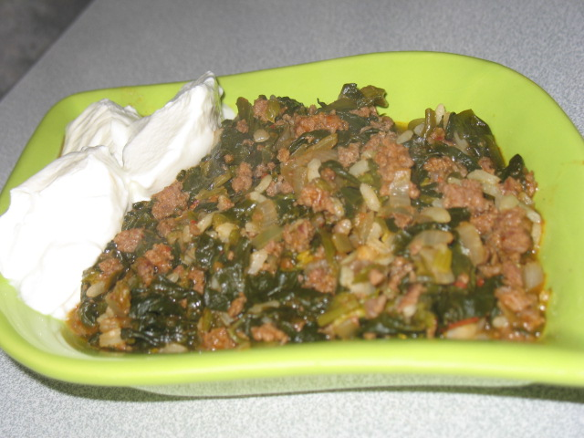

Slide 12
Turkish Folk Dances

Slide 13
Turkish Folk Dances
Bar (dance)
With their structure and formation, they are the dances performed by groups in the open. They are spread, in general, over the eastern part of Anatolia (Erzurum, Bayburt, Agri, Kars, Artvin and Erzincan provinces). The characteristic of their formation is that they are performed side-by-side, hand, shoulder and arm-in-arm. Woman and man bars are different from one another. The principal instruments of our bar dances are davul and zurna (shrill pipe). Later, clarinet has been added to the woman bars. The dominant measures in bars are 5/8 and 9/8. Occasionally measures of 6/8 and 12/8 are used. Aksak 9/8 measures which are also the most characteristic measures, in particular, of the Turkish folk music are applied with extremely different and interesting structures in this dance. They normally wear costumes as they dance. They always dance with pride and they turn their hands as they hop dance. It attracts a lot of people

Slide 14
Turkish Folk Dances
Halay
This folk-dance, is a part of Turkish dance and is performed to a large extent in the Eastern, South- Eastern and Central Anatolia and it is one of the most striking dance. It has a rich figure structure of simplicity is the symbol of creation and originality of the folk. The rhythmic elements of halay dances are very rich and are mostly performed with drum-zurna combination as well as with kaval (shepherd's pipe), sipsi (reed), cigirtma (fife) or baglama (an instrument with three double strings played with a plectrum) or performed when folk songs are sung.

Slide 15
Turkish Folk Dances
Horon
The horon , which derives from the Greek word choros (Greek: (ο) Χορός) meaning dance in both ancient and modern Greek, Turkish: Horon, is a dance style found in the Black Sea region, now modern Turkey. The dances called Horon derived from the Greek culture of the area and are circular in nature, each characterized by distinct short steps. HORON or the round dance is a typical folk dance of the Black Sea coastal area and its interior parts. Horons appear very different from the folk dances in other parts of the country with their formation of tempo, rhythm and measure. Horons are performed, in general, by groups and their characteristic measure is 7/16 For their melodies are rendered very fast, it is very difficult to render them with every instrument. For this reason, rendering with a drum and zurna becomes practical. Melodies of horon are performed with the small type of zurna which is called 'cura'. In addition, in the interior parts blowing instruments such as bagpipe mey (again, a small zurna) etc. The other measures used are 2/4, 5/8 and 9/16.

Slide 16
Turkish Folk Dances
Zeybek
Zeybeks are, in general, the widespread folk dances of the Western Anatolia. It is rendered by one person or two or by a group of people and its name changes for example as 'seymen' in the central parts of Anatolia. Zeybek dances are formed, in general, of 9/8 measures and have a variety of tempos such as very slow, slow, fast and very fast. Very slow zeybek dances have the measure of 9/2, slow ones 9/4 and some others 9/8. Very fast dances, for instance, teke (goat) dance seen in Burdur - Fethiye region can be regarded as dances of zeybek character, they have the traditional measure of 9/16 There is another folk dance named as BENGI in the zeybek region. It is performed more differently than zeybek and has got a different musical feature and the most characteristic measure of bengi dance is 9/8. Particularly in slow zeybeks, the traditional instruments is drum- zurna combination. The use of 2 drums and 2 zurnas in combination is a tradition, function of one of the zurnas is accompaniment, in other words, it accompanies the melody with a second constant tune. Apart from drum-zurna, a three-double string instrument baglama, reed, marrow bow etc. are used for fast zeybek dances. In particular, the traditional instrument of the teke (goat) dance region is reed.

