Slide 1
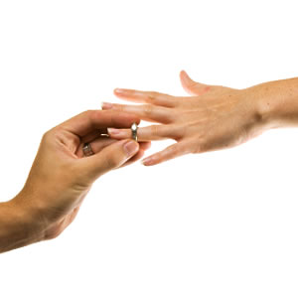
Engagement in Turkey

Slide 2
The step after the ceremony for agreement to marry is engagement. The engagement ceremony is held in the bride’s home and the costs of the ceremony in some regions are borne by the bridegroom’s family, but many times by the bride’s family.
After designating the date for engagement ceremony an invitation called “invitation to neighbors” is made. Guests who gather together on the day of engagement in the bridegroom’s home go to the bride’s home. In the traditional sections of the community, women and men sit separated in the bride’s home, and after having lunch, jewelry called “takı” is given to the bride who is dressed in special engagement dress given to her by her mother-in law and relatives of the bridegroom. In some areas the bridegroom does not come to the bride’s home. In this case engagement ring is worn by the bride via a woman coming from the bridegroom’s home. In an engagement ceremony where the bridegroom is present rings worn by the bride and bridegroom are placed by an old man on ring fingers of their right hand with accompaniment of standard words and wishes.

Slide 3
In many engagement ceremonies today, the ceremonies become more elaborate and modern, where wedding halls are rented and men and women sit together, music, mostly live, is played and the engagement is celebrated by family and friends of the prospective bride and groom.
No definite rule is imposed for the length of the engagement. Rather it depends upon agreement by both sides. While it is considered natural that engaged couples may meet each other in more modern communities, in traditional, rural communities, such meetings are allowed only through the permission of the parents and usually a family members accompanies the couple. Breaking off an engagement is considered a serious matter and is frowned upon in traditional circles. If the party who broke off the engagement is the girl, all jewelry that she received must be returned to the former fiancé. If the man broke off the engagement, usually his former fiancée keeps the presents.

